Slide 1
Activated Oncogenes
P53
Signaling altered in 87%
CDKN2A
(ARF)
Homozygous deletion, mutation in 49%
MDM2
Amplification in 14%
MDM4
Activated Oncogenes
Amplification in 7%
CDKN2A
(ARF)
Homozygous deletion, mutation in 49%
TP53
Senescence
Mutation, homozygous deletion in 35%
Apoptosis
Amplification in 14%
MDM2
MDM4
Amplification in 7%
TP53
Senescence
Mutation, homozygous deletion in 35%
Apoptosis

Slide 2
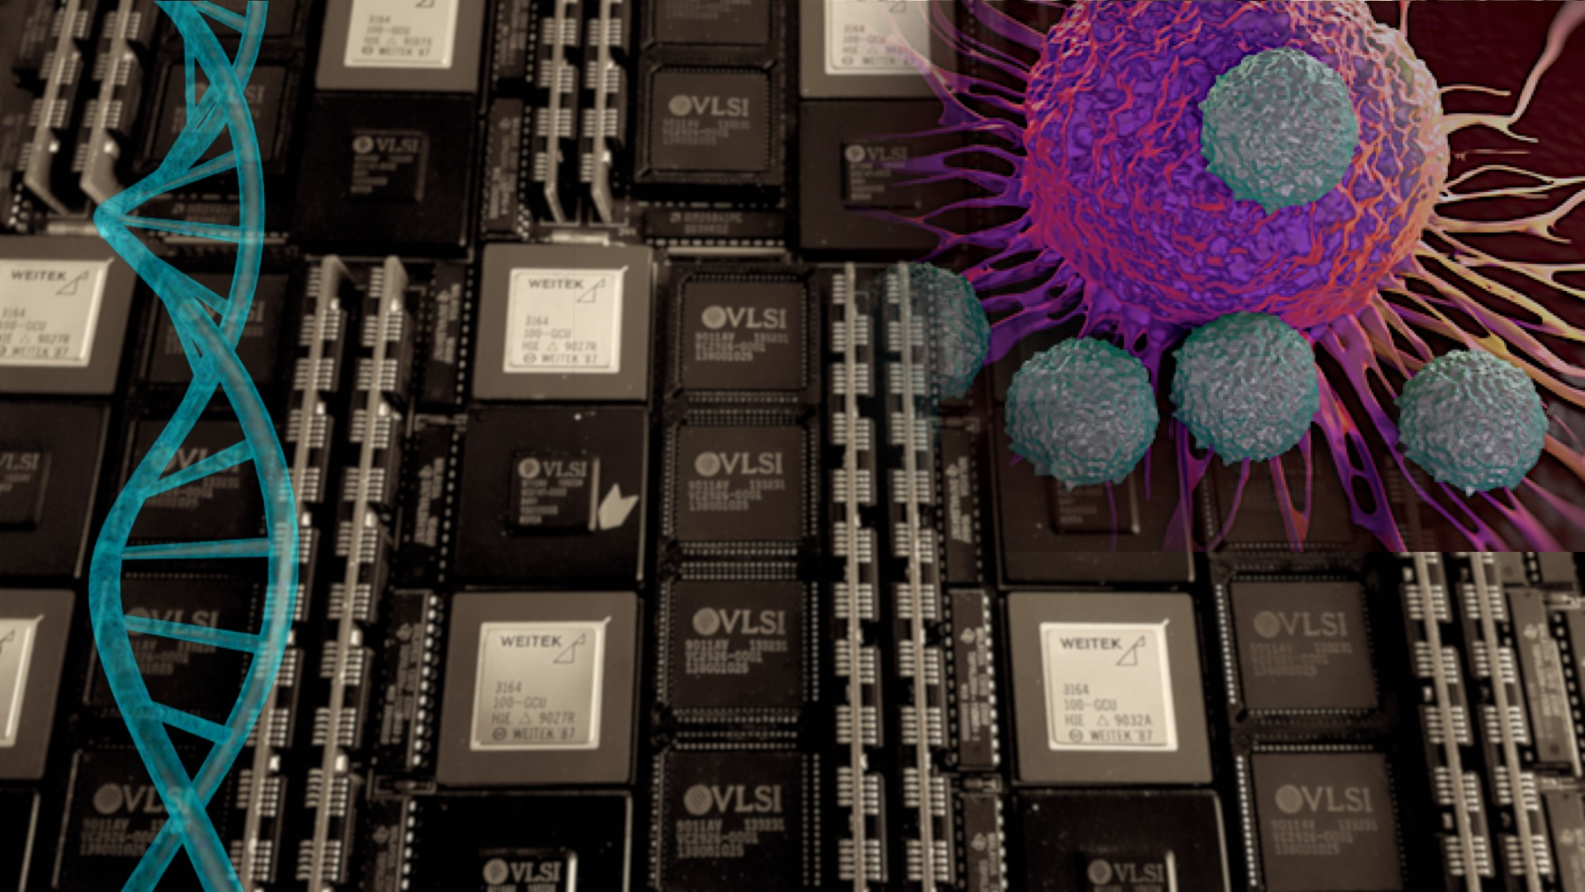
Activated Oncogenes
P53
Signaling altered in 87%
CDKN2A
(ARF)
Homozygous deletion, mutation in 49%
MDM2
Amplification in 14%
MDM4
Amplification in 7%
TP53
Senescence
Mutation, homozygous deletion in 35%
Apoptosis

Slide 3
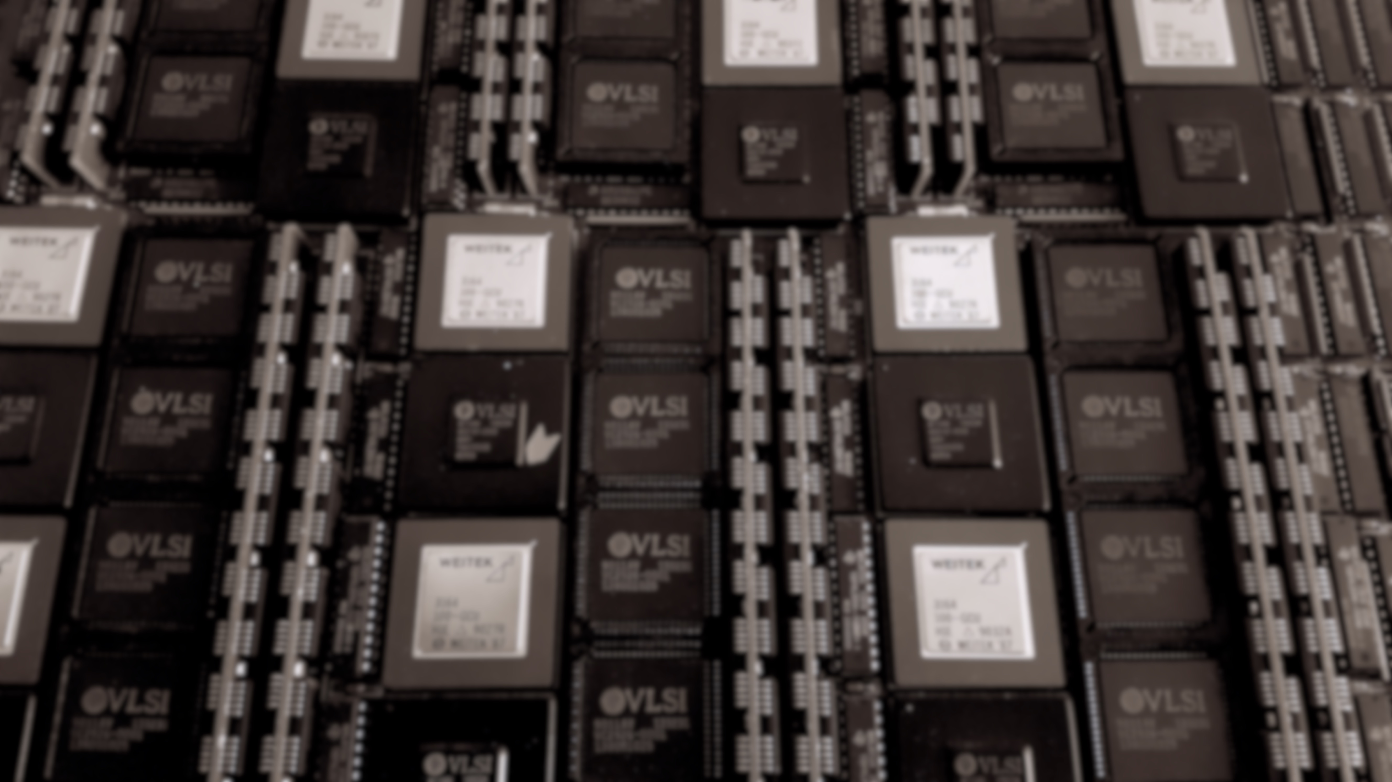
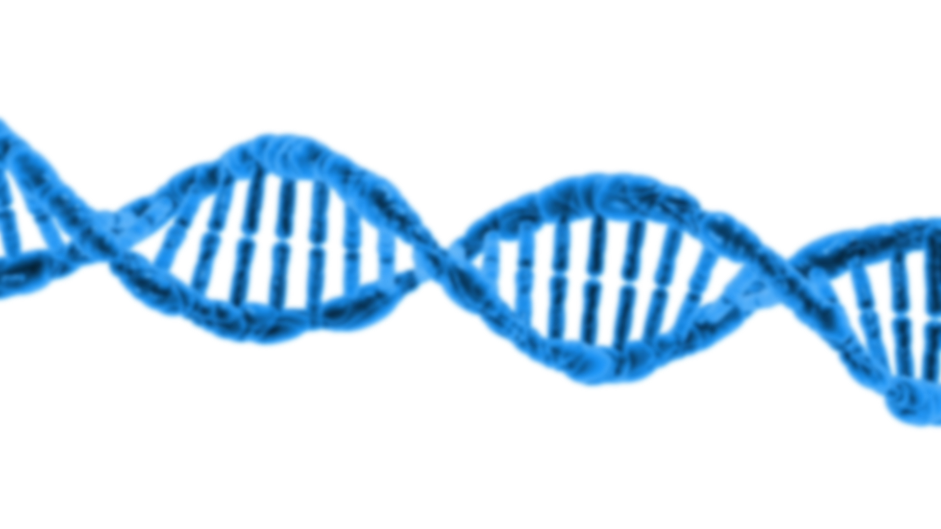
P53
Signaling altered in 87%
Activated Oncogenes
CDKN2A
(ARF)
Homozygous deletion, mutation in 49%
MDM2
Amplification in 14%
MDM4
Amplification in 7%
TP53
Senescence
Mutation, homozygous deletion in 35%
Apoptosis

Slide 4
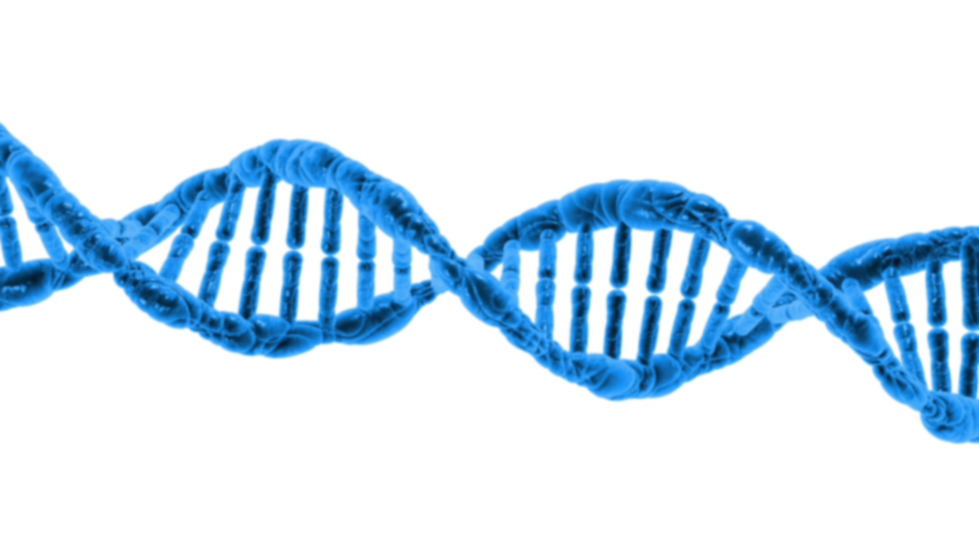
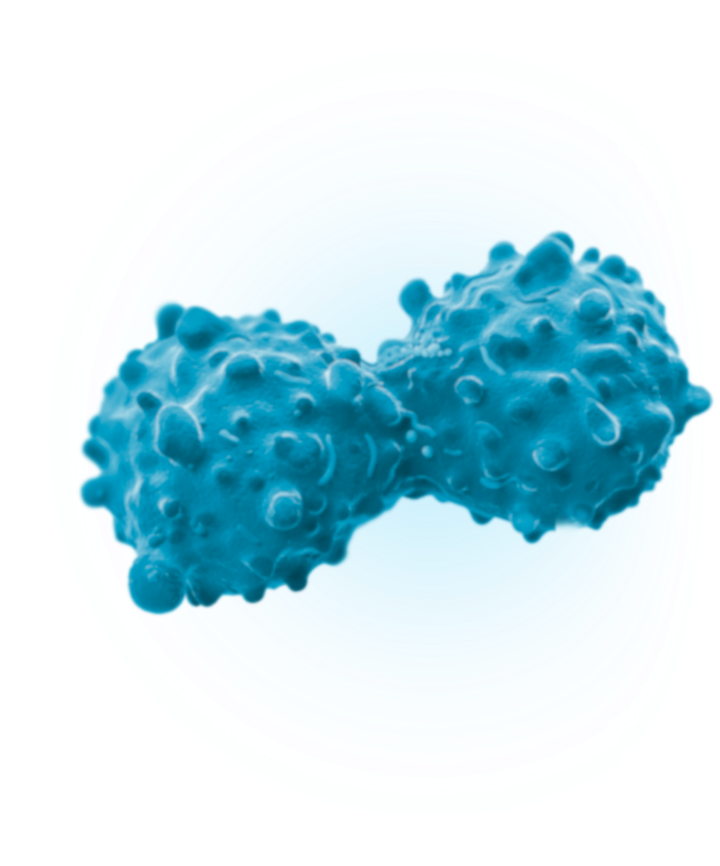
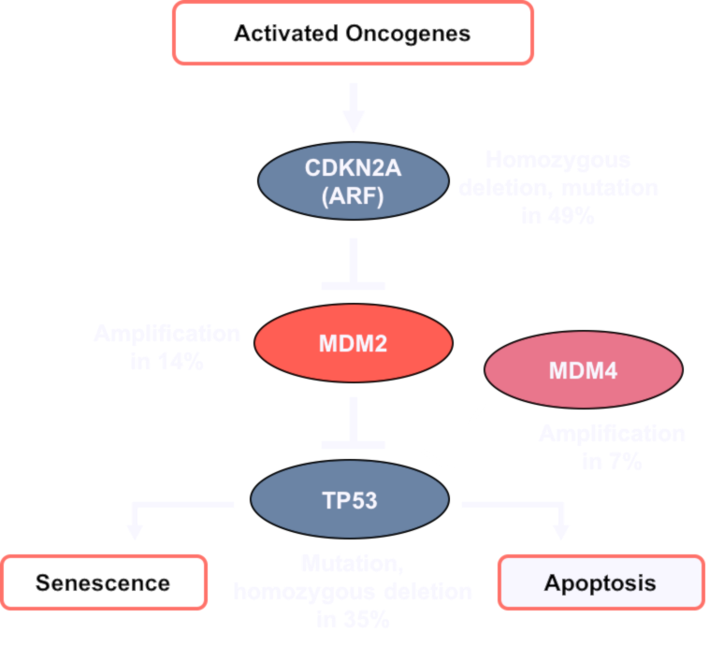

Slide 7
